Slide 1

Contract Monthly Claim System
PROG6212 POE PART 3
St10449143
Group 2

Slide 2
Project Overview
The Contract Monthly Claim System is an innovative web-based system designed to streamline the managing and assess of contractual claims. This complete system responds to the intricate workflow requirements of contemporary institutions by providing a structured, secure and efficient process for administering lecturer claims from submission through adjudication and payment processing. The system is a modern alternative to the tradition paper system, and manual approval chains, by enabling an automated, transparent digital workflow that mitigates administrative burden, while also ensuring institutional compliance and financial accountability.
Key Benefits:
- Provides audit trail capabilities with detailed tracking of every claim’s path through the approval chain.
- Streamlines payment processing by integrating approval workflows with financial system requirements
- Enhances communication between lecturers, coordinators and management through real-time status updates

Slide 3
System Architecture
CMCS is based on a scalable and secure technical architecture that utilizes current web development technologies and secure enterprise-level authentication. The framework follows a traditional three-tier architecture utilizing separation among presentation, business logic and data layers, which allows for easier maintenance and future extensibility. The presentation layer utilizes ASP.NET Core MVC with Razor Views for a responsive and easy-to-use interface designed compatible with any device. The business layer is built in C# with Entity Framework Core providing data persistence operations, while data persistence is managed with SQL Server acting as the database backend and a full integration of ASP.NET Core Identity framework managing all authentication and authorization needs.

Slide 4
Part 2 to Part 3 Updates
Addressing Lecturer Feedback:
The work from Part 2 to Part 3 entailed considerable design improvements that specifically addressed the key Lecturer feedback about separating the roles and the simulation of authenticating. It was recommended that the roles of Academic Managers and Programme Coordinators needed to be considered separately and they were independent roles. To implement this feedback the workflow was redesigned to incorporate two distinct interfaces, two approval processes, and two distinct security contexts for Academic Managers and Programme Coordinators.
To further adhere to the feedback, separate session management systems were developed for each role independent timeout and validation mechanisms.
Role-based route protection was implemented that prevents unauthorized access to role-specific functionality.

Slide 5
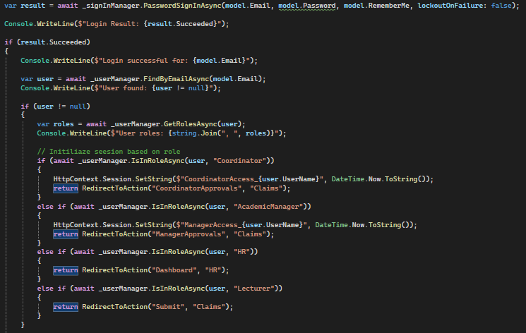
Multi-Role Authentication System
The login method is the fundamental aspect of the system's role-based access control mechanism. After the user has successfully logged in, several actions occur to facilitate role-based routing and session management. Specifically, the system begins by retrieving the full user object from the database and gathering all roles assigned to the user account. It accomplishes dynamic role-based redirection, meaning that each role type is sent directly to its designated point of entry in the application: Programme Coordinators go to their approval view, Academic Managers go to their final approval dashboard, HR goes to the management console, and Lecturers go to the claim submission portal.
The session initialization is especially important for roles with heightened permissions. For the Coordinator and Academic Manager roles, the system initializes role-specific session keys to register the initial time of access to track session time-out validation and prevent role mixing. This process ensures that the user immediately accesses the functions of the application relating to that role, while ensuring strict role-bound security. The anti-forgery token validation provides additional security to counter cross-site request forgery attacks, and as such is both user friendly and secure.

Slide 6
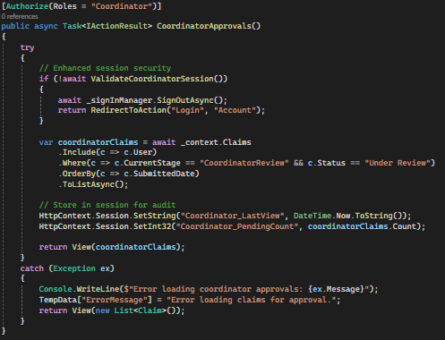
Programme Coordinator Workflow Implementation
The Coordinator Approvals method demonstrates the workflow management system implemented for Programme Coordinators. The method begins with strict session validation through the ValidateCoordinatorSession method, ensuring that only properly authenticated Coordinators with active sessions can interact with this function. If the session is not validated, the system automatically signs the user out and directs them to the login page, preventing any unintended access to designer secured features specifically for coordinator users.
The data retrieval logic shows careful filtering of data and only returns claims that require action from the Coordinator, specifically the claims where the status is described as ‘Under Review’ and claim stream is ‘Coordinator Review’. This logging to the Coordinator allows for greater and directed only review of relevant claims rather than all potential claims, improving efficiency and minimizing cognitive load and distractions allowing for higher quality assurance of claims. Within the data context provided through retrieval method Include, the Coordinator is made aware of user data context of the lecturer submitting the claim, while reasonable ordering of submission dates ensures that the process is undertaken impartially on the first-in-first-out approach.
The session tracking is also implemented alongside with a recording the last accessed time for the sake of audit, the count of pending claims for performance tracking and offers evidence for dashboard statistics. Error handling is thoroughly tested and implemented in a manner that ensures if any form of database issue or system error occurs that it is dealt with appropriately without compromising known static of the system, even when an exceptional condition occurs.

Slide 7
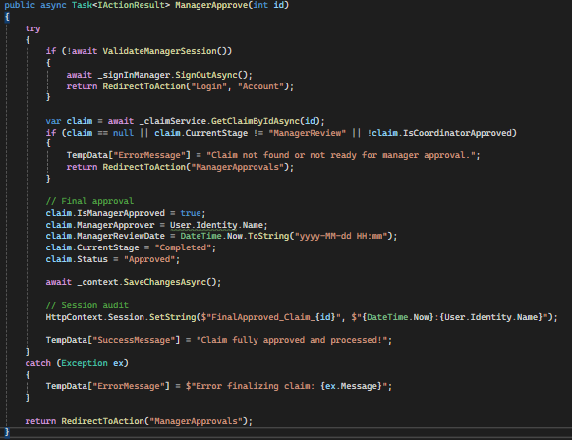
Academic Manager Workflow Implementation
The ManagerApprove method represents the level of authority and provides all levels of oversight for the role of Academic Manager in the claim approval workflow. It starts with checking of session validity specific to the Manager role, verifying that only authorized Academic Managers with active sessions can have a role in the ManagerApprove, and complete the final approval. This check is an important part of processes to ensure the approval chain remains valid and ensure unauthorized final approvals cannot be accepted.
The logic for checking the claims reflects the system's enforcement of proper workflow progression. Before granting any final approval, the logic checks that the claim exists, that it is in the correct "ManagerReview" stage, and that it has already been approved by the Coordinator. This multi-faceted check prevents bypassing the workflow and ensures that the claims proceed through the required approval hierarchy. The approval process involves multiple data updates that fully document the final approval: setting the manager approval flag, recording the manager's identity, timestamping the approval decision, updating the workflow stage to "Completed", and changing the overall status to "Approved".
The implementation of an audit trail of the session provides critical documentation of compliance by recording exactly when and by whom each final approval was conducted. This audit function supports institutional accountability, while also providing data for performance evaluation and process improvement. The comprehensive error handling allows for any issues to be relayed to the user while maintaining stability in the system during the approval process. This method reflects the end of the claim approval process as the Academic Manager functions as the final authority in the institutional weapon approval chain.

Slide 8
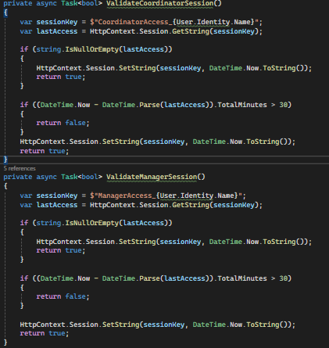
Session Management & Security Implementation
The methods for session validation represent a sophisticated method of role-based session management with integrated considerations for security and usability. Each actual role type independently tracks the session, and each has unique session keys that comprise the role context and user identity. This prevents session overlap between roles and ensures that a user cannot utilize functionality outside the authorized role's scope.
The sliding expiration in the user experience space is important - after each validated access, session expiration time is extended, allowing the user to continue working in a consistent fashion while in an active session. However, the 30-minute maximum is strictly enforced to end abandoned session activity. By maintaining the separation between Coordinator and Manager session validation, a user can have multiple roles and the session tracker maintains independent tracking for each role. This security approach keeps robust security and flexibility intact while holding the emphasis of role separation that is articulated in the project requirements, ensuring that Program Coordinators and Academic Managers work from entirely separate security contexts.

Slide 9
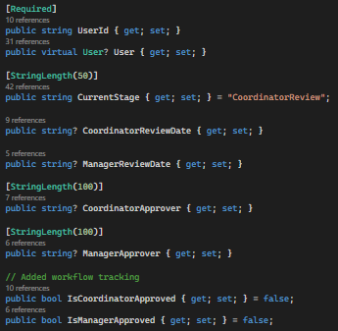
Claim Workflow Model Design
As the primary object around which the entire workflow system is developed, a Claim entity manages complete tracking of all steps in the approval process. It begins with foundational claim information - instructor identification, time period, numerical information, and total amount. The workflow tracking properties however, shows the system’s ability to manage complex multi-stage approval processes while maintaining full audibility. The CurrentStage property tracks where the claim resides in the workflow process - it starts with the initial "CoordinatorReview" status so that claims will always route to Programme Coordinators on a new claim. The system also supports a unique boolean for IsCoordinatorApproved and IsManagerApproved, allowing reports and filtering by easily recognizable approval items from each level of the approval process. The approver tracking fields allow documentation as to who approved the claim and any changes to approval status can be explored further if required.
The timestamp fields for each review stage provide temporal context for the approvals, supporting performance analysis and process efficiencies of the reviews. In addition, the overall Status field works with the tracking of each stage to provide status information at a high level. Additionally, the relationship to the User entity connects claims to their submitter and enables user-oriented claim history and departmental reporting. The thoughtful design of the entities supports the entire process, from submission through final approval, allowing for thorough auditing and complex reporting options.

Slide 10
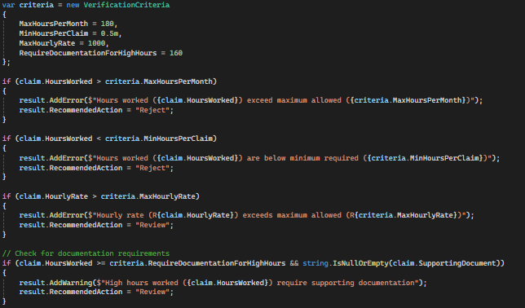
Automated Claim Processing
The automated claim validation service encapsulates the rules and approval policies for the various paths the claim flows through the claim processing system. It conducts extensive validation against multiple dimensions of rules, including simple validation of hours first in terms of minimum and maximum allowable with respect to institutional policy. The maximum of 180 hours is intended to be the limit of a full-time equivalent for a month; conversely, the minimum will only allow for 0.5-hour periods of work to be claimed, meaning the assignments are productive for the agency.
The auto-approval logic shows more complex implementation of the business rules, in which claims up to 160 hours are auto-approved case for a typical case means regular cases can be processed without human involvement. Automating this process mitigates administrative burdens for Coordinators while maintaining compliance for institutional policy.

Slide 11
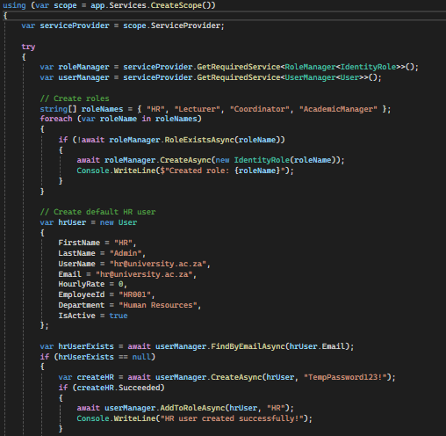
Database Seeding & Role Management Infrastructure
The database seeding function is an important because it ensures the system is fully seeded prior to operation, incorporating all required roles and sample users built for demo and development purposes. The seeding occurs in an appropriate service scope that properly manages the database connection and dependency injected into the application, displaying production-ready behaviours for application initialization. The comprehensive error handling ensures any seeding errors are correctly logged, without crashing the application, while allowing the system to continue functioning if initialization experiences issues.
The role creation function will create each of the four distinct roles that characterize the different roles in the claims processing work streams. In each case, a check is performed, making the process of seeding seamless, so it can be run multiple times without error, should roles need checked initially or if it needs run in maintenance where roles need verified. The console logging will allow the developer or application support person to observe the role created or previously existed.

Slide 12
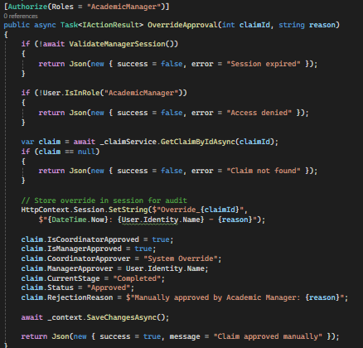
API Integration
The Contract Monthly Claim System includes advanced Web API distribution endpoints that permit dynamic interactions with the client-side while maintaining the strong validation and security requirements of the main application. The Web API endpoints represented a hybrid model that takes advantage of the stability of server-side MVC investment and the responsiveness of modern web applications, therefore offering powerful options for Academic Managers managing exceptional case and workflows.
Security Design Principles of APIs:
The OverrideApproval API endpoint demonstrates the system's emphasis on security-first design principles. In contrast to the traditional model view controller (MVC) action that returns views, this endpoint will return structured JSON data, allowing the client to interact dynamically while keeping all the security restrictions from the main application intact. When the method is called, it begins with a rigorous multi-layered security check that verifies both session validity and role membership before processing any business logic. Therefore, security remains consistent not just for regular controller actions but also when API action points get invoked.
Session Management for APIs:
Any session validation and porousing whether a user session was called is especially significant for API endpoints since they can be called asynchronously from client-side JavaScript. Without any kind of check, the ValidateManagerSession() method will not only ensure the Academic Manager session is valid but also an unauthorized API call can be easily done before validating the session. It validates the Academic Manager session again on the server to provide additional protection. Clients do not have an infinite amount of time to sit in a web browser which could lead to exposes of a session during a legitimate session. All server validation methods will always provide careful policy protection in case a client-side measure fails for any reason. Along with client-side session validation, on the server, the policy is nice support and provides additional security to the user while they use the application.

Slide 13
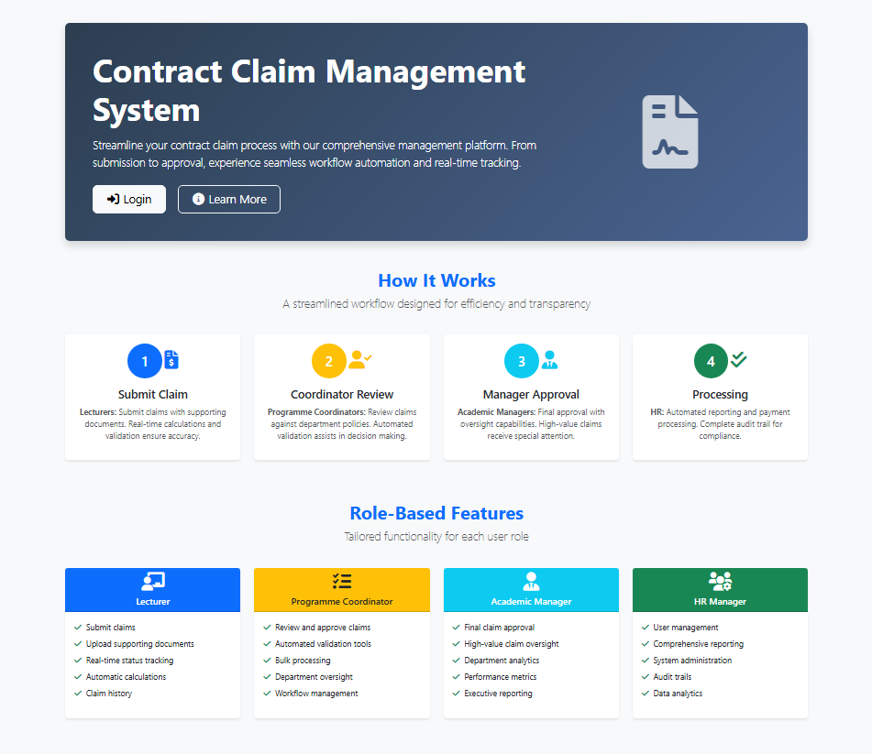
Home View UI
The Home UI the main portal for all claim submissions for Lecturers providing a straightforward and easy-to-use front end to start the entire workflow. When lecturers log in, they will see a form-style interface where claims can be created for the different months, entering requisite information from the claim period, as well as inputting module codes and hours by breakdown. This interface encourages clarity and efficiency, with real-time validation that monitors data entry errors and compliance to policies, as verifying hours do not exceed the institution's maximum at the time of entry. Upon submission, the claim instantly enters workflow with an initial status of "Under Review," and it is routed to the respective Programme Coordinator. The same interface provides a robust authentic history of claim submissions so that the lecturers have a status overview of previous claims, reducing the need to follow up.

Slide 14
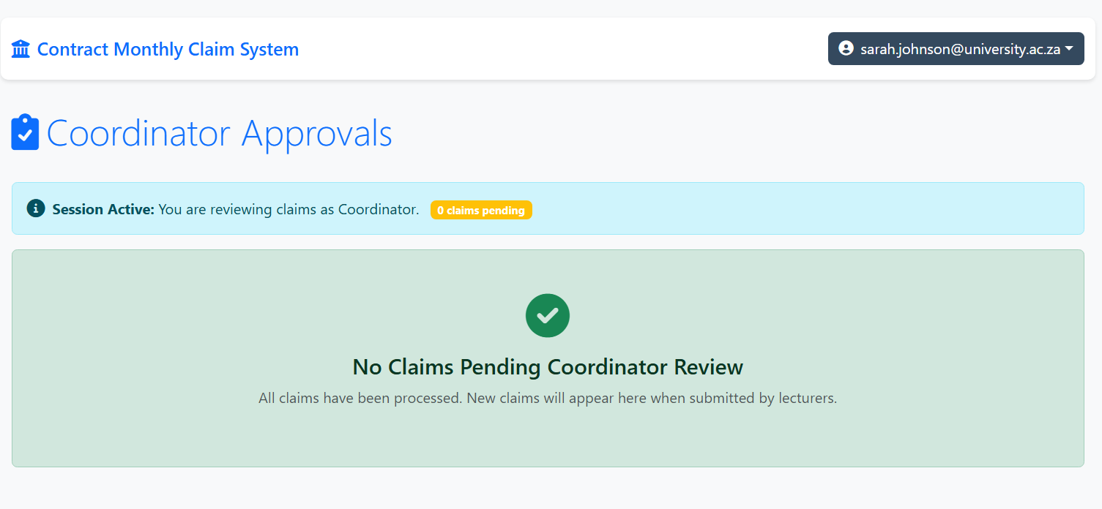
Coordinator Approvals
The approval view for the Programme Coordinator is an dashboard built specifically for the first line of assessment, which provides additional screens to reflect the lecturer's feedback to establish different views tied to their role. This screen serves a unique function by filtering out and showing only those claims in the Coordinator Review stage that require the attention of the Coordinator. The screen presents claims in a list or table format, prioritized by submission date order, with the opportunity for the Coordinator to deep dive into each claim to validate hours, supporting documents and policy compliance. The only action to take place on this screen is the brightly coloured "Approve & Forward" button and workflow that it pushes the claim to the next identifiable rank in the hierarchy, the Academic Manager.

Slide 15
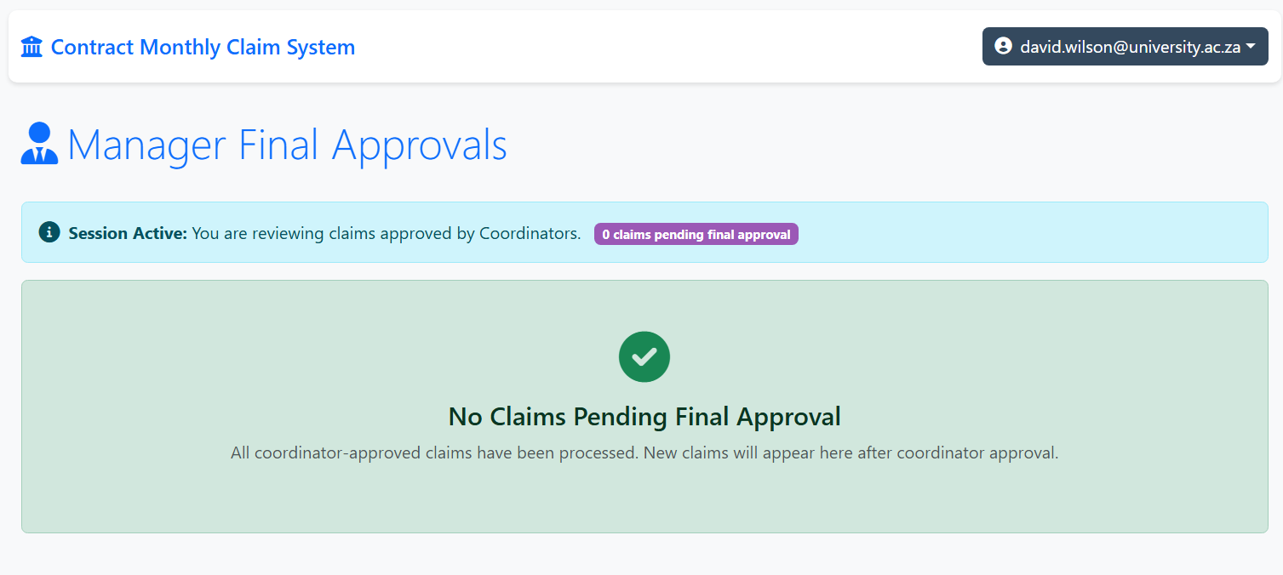
Manager Final Approvals
The Academic Manager's final approval dashboard allows for strategic oversight specific to the institution, capturing the full separation from the Coordinator role as required in the feedback. This view is fundamentally different; it only shows claims that have passed the Coordinator review and are now at the Manager Review stage. The display is built for final authority and summarizes important information such as claims value and who requested the claim, so the Manager can take final action with the "Final Approval" button that completely breaks the approval workflow. This semantic difference from the Coordinator role's "Approve & Forward" action is important because it shows distinction visually and technically on the Manager as the final authority in the chain of approval

Slide 16
User Interface Design & Role-Based Experience
The user interface design ideology is centred around creating role-based experiences that drive workflow efficiency and user consistency across the system. Each role sees interfaces that are aligned with their responsibilities, with navigation, information visualizations and available actions changing depending on the user's role within their organization. For example, Programme Coordinators will see interfaces that most closely relate to department oversight and first-time validation, while Academic Managers will see dashboards that summarize information while placing emphasis on final approval authority and institutional oversight.
Difference between Programme coordinator(PC) and Academic Manager(AM):
PC: Department level claims review with emphasis on adherence to policy and validation of hours
"Approve & Forward" action buttons that clearly indicate to the user that the action being taken advances the claim to Manager Review
AM: Perspective of institutional oversight as it relates to high dollar value claims and claims needing exceptions
"Final Approval" authority actions that indicate the end of the review workflow.
Shared UI Consistency Elements:
Common navigation and information architecture patterns across all role interfaces.
Consistent visual design language by using institutional colours.
A continuous user journey with the same status indicators and progress tracking across all workflow stages.
Consistent form design and validation patterns to create a similar user experience across workflow stages.
Responsive design principles to ensure the best user experience across desktop, tablet, and mobile devices.

Slide 17
Key Part 3 Features
Part 3 implementation is a major step forward in system capacity and architectural philosophy, with an emphasis on clearly defining the separation of roles between Academic Managers and Programme Coordinators. It demanded substantial changes to every layer within the application stack, ranging from database schema changes, to logic changes, to changes within screens. The implementation offers an excellent response to the lecturer's recommendations, while at the same time preserving overall integrity of the system, with several notable new capabilities that support academic administration needs that exist in the real world.
Enhanced Workflow Management:
Designed and coded advanced status tracking that clearly identifies the distinction between Coordinator review and manager approval
Developed complete audit trails, including complete documentation of approval chain history
Designed and coded automated workflow routing that enables claims to progress through the traditional organizational hierarchy of approval
Implemented organization role-specific validation rules that consider the different contexts of decision-making by role
Security and Compliance Improvements:
Developed sophisticated session management with role-specific timeout validation and automatic logout protections
Implemented auditing and logging of significant actions with the approval process

Slide 18
Conclusion
The Contract Monthly Claim System is a capable, solution ready for production that can easily manage the complex multi-stakeholder workflow demands associated with academic claims processing environments. With comprehensive enhancements to the architecture in Part 3 of the project, particularly in a refined separation of roles between Academic Managers and Programme Coordinators, the system and models in detail the actual organizational structure and approval hierarchy of contemporary educational systems. This implementation allows for both theoretical workflow design to be put into actual administrative use, while establishing role boundaries, levels of approval authority and user-friendly interfaces accurately depicting the operational system in which academic institutions engage. The system successfully strikes a balance between sophisticated automation and the need for oversight where recurring claims can benefit from intellectual validation and processing and atypical cases benefit from human discretion for assessment and judgment in more complex organizational decision-making processes. The Contract Monthly Claim System effectively is not just dynamic technology but implements dynamic capability to change the processing of claims to a whole new process differentiation from prior methods of an administrative function, articulated as a means to be a highly efficient, transparent and business-oriented approach that ensures the broader educational mission of the institution can be upheld.

